Slide 1
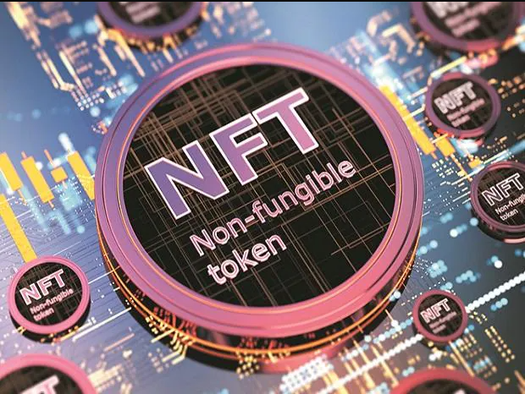
NFT AND ITS MARKETPLACES IN BLOCKCHAIN
Name:- Shubhamkumar Yadav
Roll no. :- 25

Slide 2
What is Blockchain?
A Blockchain is a chain of blocks that contain information. It is a system of recording information in a way that makes it difficult or impossible to change, hack, or cheat the system.

Slide 3
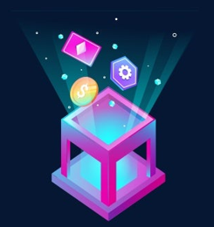
Definition of NFT
A non-fungible token or NFT is a type of digital token.
This type of token can't be interchanged or replaced as every token comes with unique attributes.

Slide 4
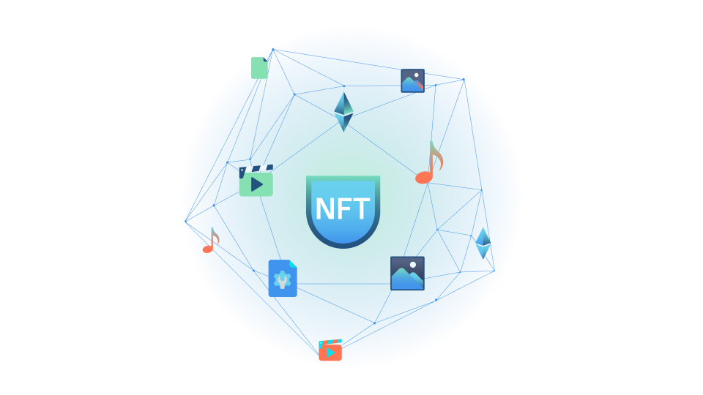
Examples of the most interesting use cases of nft
Digital art
Sports
Fashion
Virtual real estate
Music NFTs

Slide 5
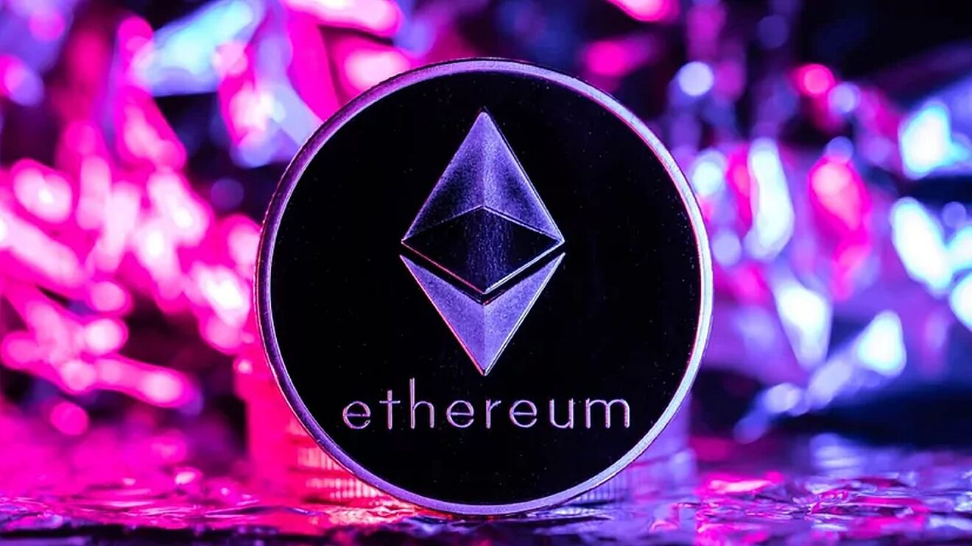
NFT blockchain options
Ethereum
Binance Smart Chain
Tron
EOS
Solana
Cosmos
Hedera Hashgraph

Slide 6

Common Features of NFTs
Uniqueness
Digitally Scarce resource
Indivisible
Ownership
Transparency

Slide 7
The Advantages of NFTs
Decentralized marketplace
Collectibles
Resell able
Immutable
Copyright
Security
Unique

Slide 8
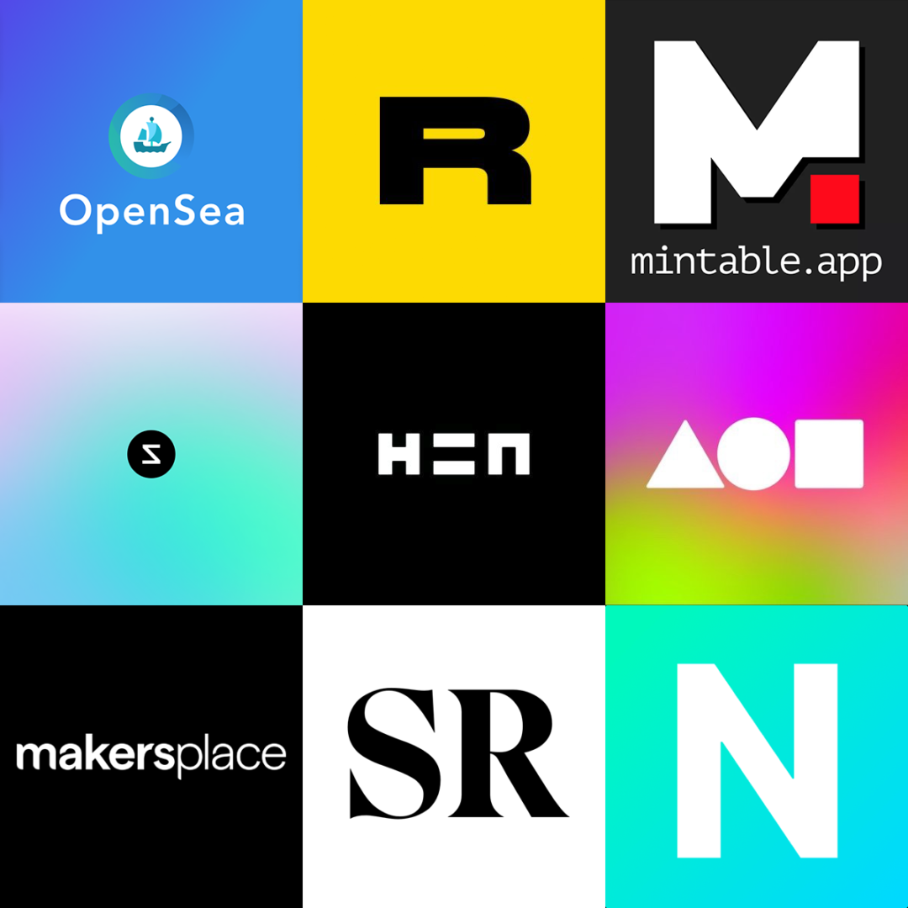
What are NFT marketplaces?
NFT marketplaces are platforms where NFTs can be stored, displayed, traded and in some cases minted (created). These marketplaces are to NFTs what Amazon or eBay are to goods.

Slide 9
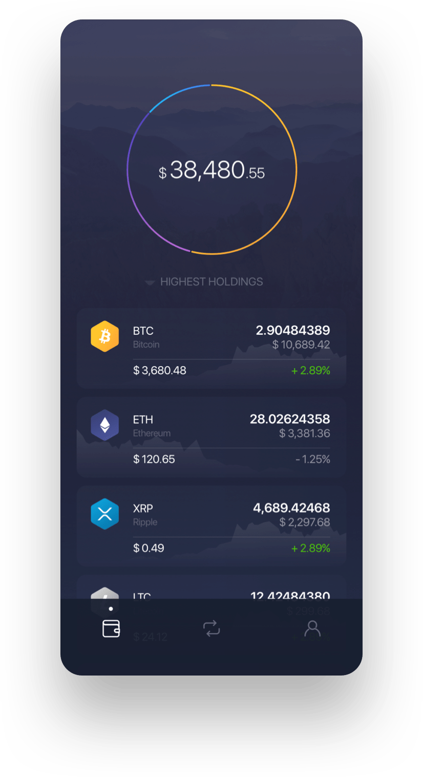
What are the salient features of an NFT marketplace?
Storefront
Filters
Auctions and purchasing
Digital wallet

Slide 10
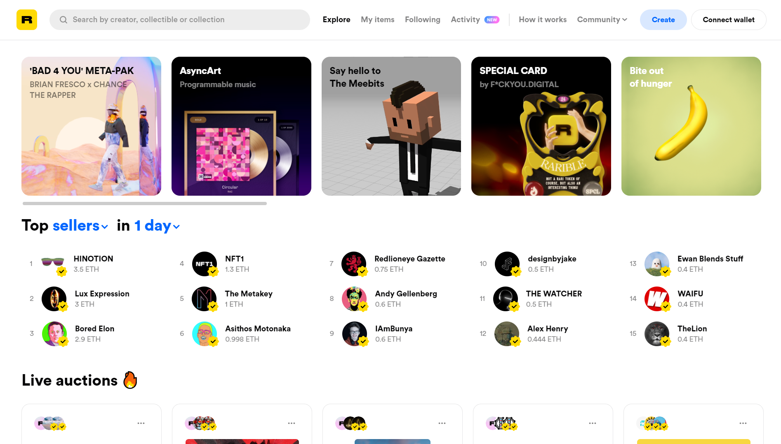
Popular NFT Marketplaces
OpenSea
Rarible
SuperRare
Nifty Gateway
Foundation

Slide 11
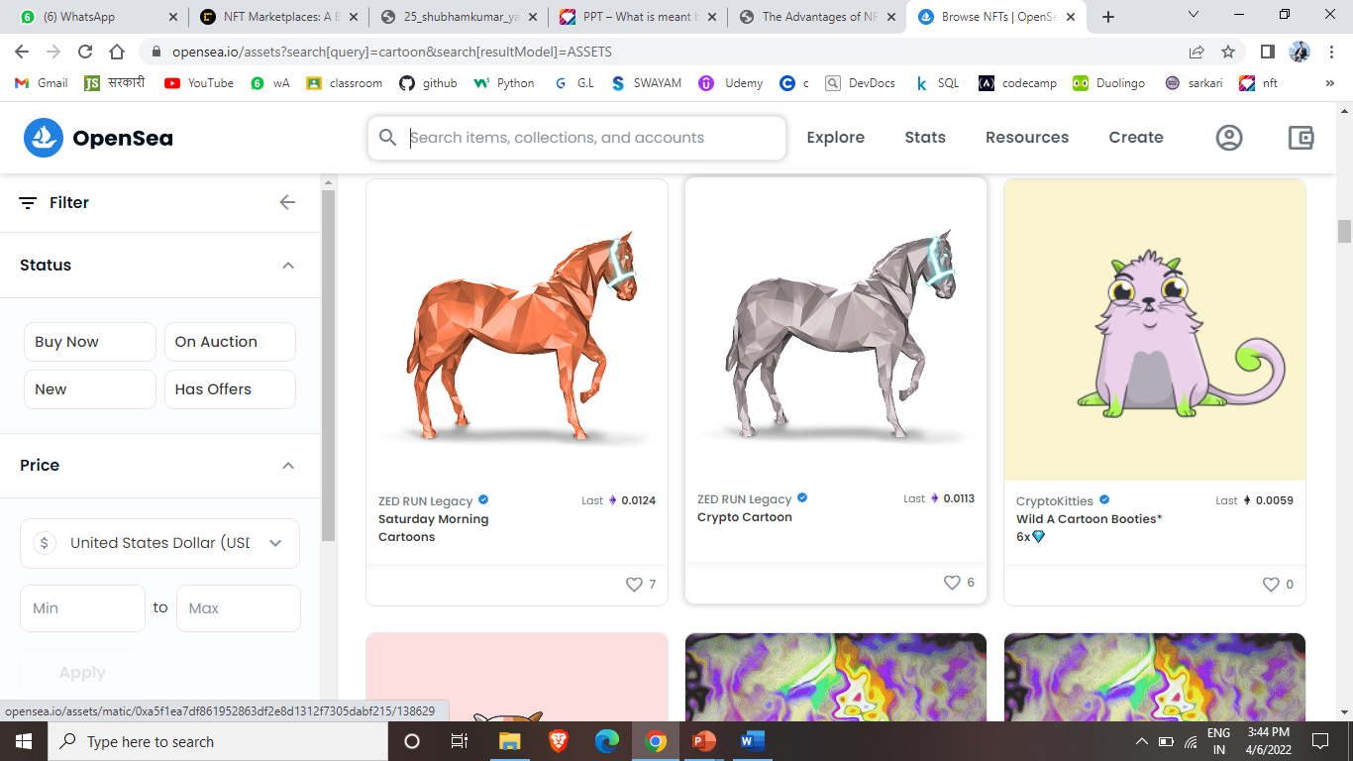
How do these marketplaces work?
Signing up
Buying an NFT
Selling an NFT
Minting an NFT

Slide 12
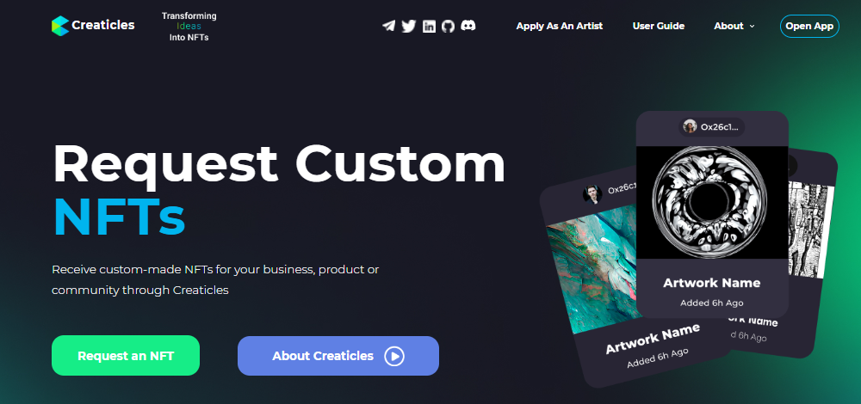
Creaticles
Creaticles’ NFT Marketplace is the first custom NFT Marketplace. Creaticles is the blockchain industry’s first custom NFT request platform that connects businesses and individuals with creators

Slide 13
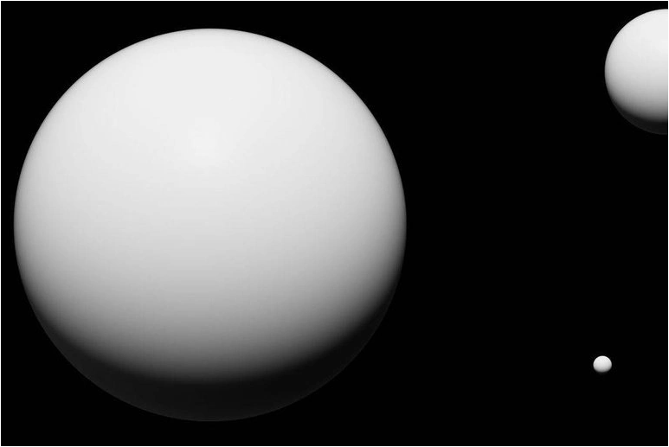
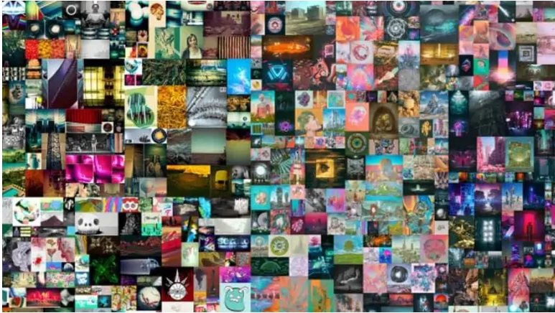
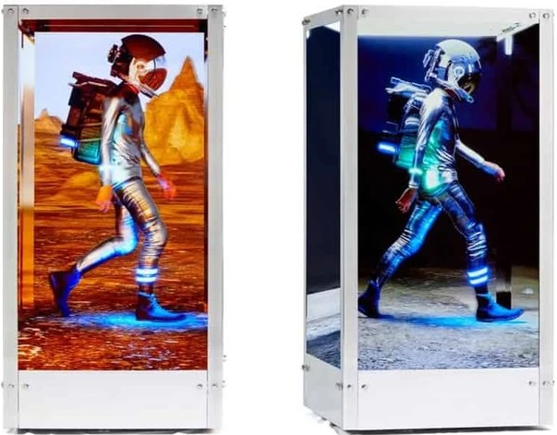
Some of the most expensive NFTs ever sold
2 – The First 5000 Days — $69M
3 – Beeple, Human One — $29.98M
1 – The Merge — $91.8M

Slide 14
Conclusion:-
Non-fungible tokens are unique pieces of data that are stored on a blockchain. Digital art, music, video clips, tickets are a few examples of the digital assets that are being converted as NFTs. Some people think that this is a bubble that will burst and some people think that NFTs will drive the digital economy. The technology is still in the initial stages, so we have to wait and watch how it evolves.

Slide 15
REFERENCES:-
https://builtin.com/
https://www.leewayhertz.com/
https://medium.com/
https://www.forbes.com/
https://creaticles.com/
https://slideshare.net/
https://www.coindesk.com/

Slide 16
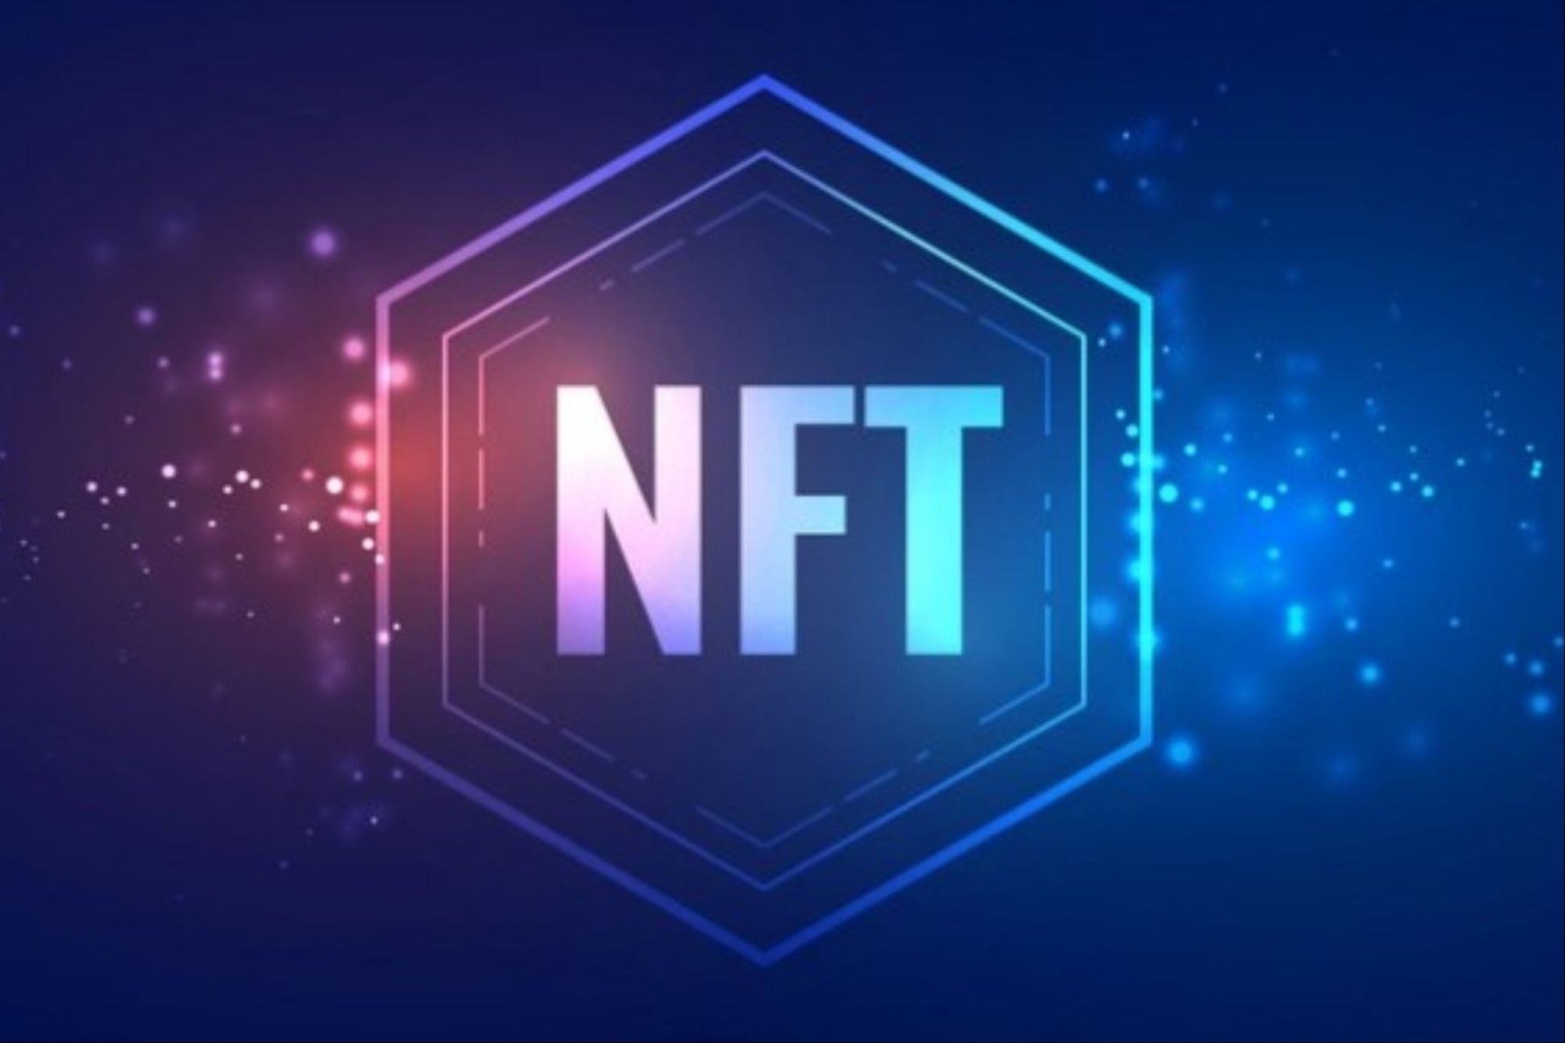

THANK YOU

